Slide 1
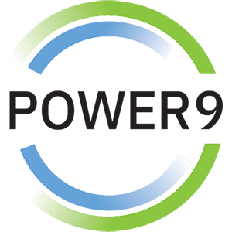
The Advantage for Running Oracle on IBM Power Systems
RAS & Resilience
Cloud
Flexibility
Economics

Slide 2
The Power Systems Mission Critical Advantage Increasing with each new generation!
RAS & Resilience
Rock solid infrastructure
Secure by design
Flexibility
A variety of options and an open ecosystem
Cloud
Leverage various cloud options – at your pace
Cloud is a capability, not a place – Power Systems are cloud-like, even on-prem
Economics
Control licensing costs
Outstanding consolidation
Long term commitment & secure roadmaps

Slide 3
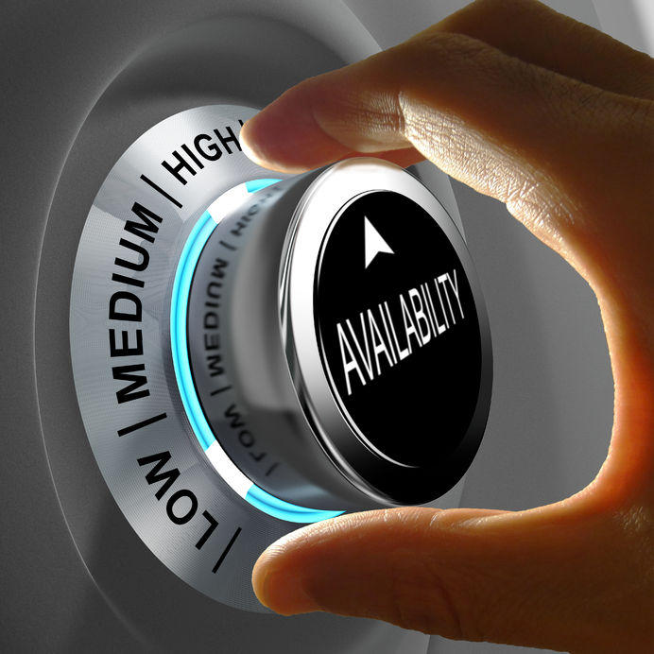
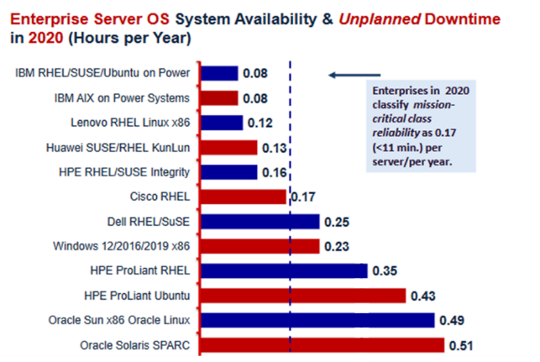
POWER Ranked Number 1 in every major reliability category by ITIC
“Among mainstream servers, IBM POWER8 and POWER9 … continue to deliver the highest levels of reliability/uptime”
Notes:
3

Slide 4
CONSOLIDATION More VMs per server More workload per server
Reduce license costs and server sprawl by doing more with less
Notes:
4

Slide 5
0
Security Vulnerabilities Reported in PowerVM
Compared to thousands in VMWare, Windows Server, KVM and other x86 hypervisors
Source: National Vulnerability Database: http://nvd.nist.gov/, as of June 10, 2020
Notes:
5

Slide 6
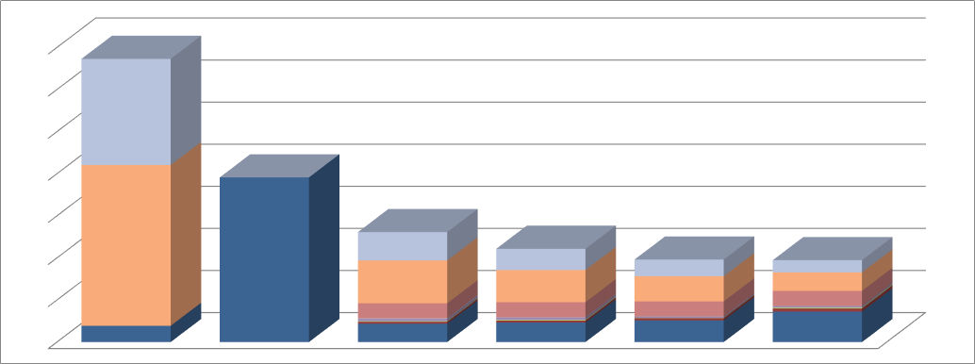
Economics – Oracle is less expensive on IBM Power than anywhere else!
Software licensing & maintenance largest part of TCO (driven by number of cores used)
Use less cores with Power and keep Oracle costs down and under control
Long term commitment and secure roadmaps with Power
3-year Oracle Maintenance
Oracle DB License Cost
System (HW)
3.5x
2x
Oracle IaaS + Licenses
Oracle
SaaS
IBM Power S922
IBM Power S924
IBM Power E950
IBM Power E980
* Internal TCO Study
Performance & Scale of POWER9 processors
> 2x perf per core vs. x86
Real simultaneous multi-threading SMT8 throughput
Better utilization of CPU capacity (via PowerVM) means less cores, less licenses, and less cost
Better granularity to scale
Hard Partitioning
PowerVM is an Oracle-approved virtualization technology for limiting cores
Cap the licensing by only paying for the cores that are running the database
Shared Processor Pools
Hypervisor can share a pool of CPUs between VMs
Exploit CPU cycles from less busy VMs in the pool
VMs running Oracle DB can run in shared processor pool, reducing Oracle licensing (more efficient than VM-based licensing or soft-partitioning)
Consolidate Oracle DBs, Software & Applications
Consolidate database and application tiers on a single server
Dev, test and production
Simplified management through reduction of servers
PowerHA and the Recovery Mangers save costs vs. Oracle RAC

Slide 7
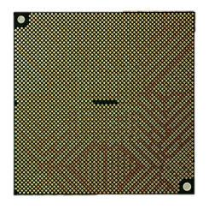
Infrastructure Matters
when you transform enterprise applications
as part of a hybrid multicloud strategy
POWER9
maintaining the scalability, reliability and security your mission critical systems provide
Better economics for today’s modern workloads

